Slide 1













RequirementAnalysis
Unit 2.3
/ Elaboration
Requirement Analysis & Specification

Slide 2

Requirements Engineering Tasks cont.
3
Elaboration
Further define requirements
Expand and refine requirements from inception & elicitation
obtained
Creation of User scenarios, extract analysis class an business domain entities
d

Slide 3





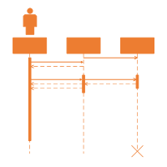

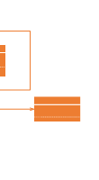
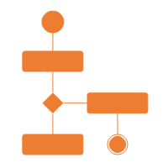
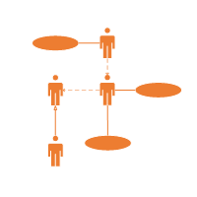
The requirement analysis model
System Description Design Model
Analysis Model
urpose | Describe what the customer wants built
 | Establish the foundation for the software design
 | Provide a set of validation requirements
P
System Information
System Function System Behaviors

Slide 4
Elements of the Req irements Model
u
Scenario-based Models
e.g.
Class Models
e.g.
Use cases User Stories
Class diagrams Collaboration diagrams
Software Requirements
Behavioral Models
e.g.
State diagrams Sequence diagrams
Flow Models
e.g. DFD
Data mosdels

Slide 5


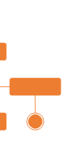

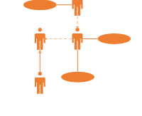

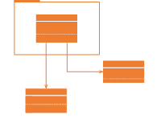
Elements of the Requirements Model
Scenario-based elements
Describe the system from the user's point of view using scenarios that are depicted (stated) in use cases and activity diagrams
Class-based elements
Identify the domain classes for the objects manipulated by the actors, the attributes of these classes, and how they interact with one another; which utilize class diagrams to do this.
Use Case Diagram
Activit
y
Diagram
Class Diagram

Slide 6
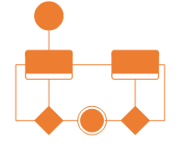
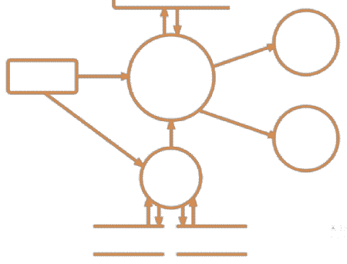
Elements of the Requirements Model
Behavioral elements
Use state diagrams to represent the state of the system, the events that cause the system to change state, and the actions that are taken as a result of a particular event.
This can also be applied to each class in the system.
Flow-oriented elements
Use data flow diagrams to sh w the input data that comes into a system, what functions are applied to that data to do transformations, and what resulting output data are produced.
o
Data Flow Diagram
State Diagram

Slide 7

Analysis rule of Thumb
Make sure all points of view are covered
Every element should add valu
Keep it simple
Maintain a high level of abstraction
Focus on the problem domain
Minimize system coupling
Model should provides value to all stakeholders
e

Slide 8



Analysis Modeling Approaches
Structured Analysis Object Oriented Analysis
Models data elements
⁻ Attributes
⁻ Relationships
Models processes that transform data
Models analysis classes
⁻ Data
⁻ Processes
Models class collaborations
Techniques from both approaches are typically used in practice.

Slide 9
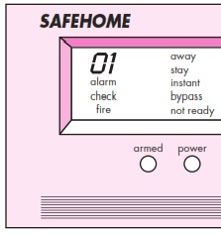
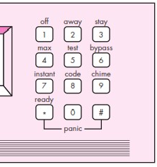
Safe Home Control Panel

Slide 10
Use-Cases
A collection of user scenarios that describe the thread of usage of a system
Each scenario is described from the point-of-view of an “actor”
Actor: a person or device that interacts with the software
Each scenario answers the following questions:
Who is the primary actor, the secondary actor (s)?
What are the actor’s goals?
What preconditions should exist before the story begins? main
What tasks or functions are performed by the actor? extensions
What might be considered as t e story is described?
A Primary actor is one havi g a goal requiring the assistance of the system
A Secondary actor is one from which System needs assistance
n

Slide 11
Scenerio Based Model :Use-Cases
What variations in the actor’s interaction are possible?
What system information will the actor acquire, produce, or change?
Will the actor have to infor the system about changes in the external environment?
What information does the actor desire from the system?
Does the actor wish to be informed about unexpected changes?
Thus
Use Case captures
who (actor) does
what (interaction)
with the system, for what with system internals
purpose (goal), without dealing

Slide 12
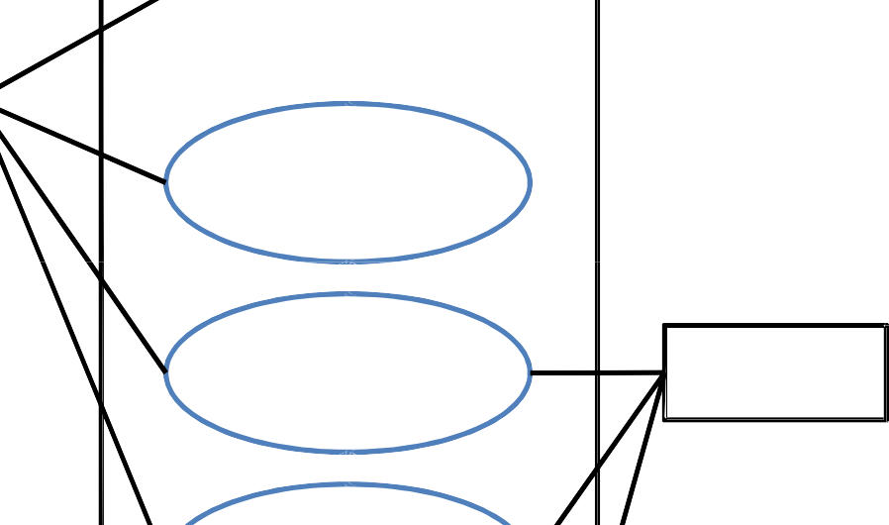



Use-Case Diagram
◻ It is referred as the diagram used to describe a set of actions (use cases) that some system should perform in collaboration with system users.
Arms/disarms System
Accesses System via Internet
Use Case diagram for SafeHome home security function
Homeowner
Responds to Alarm Event
Sensors
Encounters an Error Condition
Reconfigures Sensors and related System Features
System
Administrator

Slide 13



Use-Case Diagram
-- represents what happens when actor interacts with a system
-- captures functional aspect of the system
Actor
Relationship between actors and use case and/or between the use cases
Use Cas
e
-- Actors appear outside the rectangle
--Use cases within rectangle providing functionality
--Relationship association is a solid line between actor & use cases
34

Slide 14
Use-Case
1 Use Case Title Login
2 Abbreviated Title Login
Use Case Id 1
Actors Librarian , Me bers, Asst. Librarian
Description: To interact with the system, LMS will validate its registration with this system. It also defines the actions a user can perform in LMS.
Pre Conditions: User must have proper client installed on user terminal
Task Sequence
System show Login Screen
User Fill in required information. Enter user name and password
System acknowledge entry
Post Conditions: System transfer control to user main screen to proceed further actions
Exception: If no user found then system display Invalid user name password error message and transfer control to Task Sequence no.1
6 Modification history: Date 08-01-2018
7
Author: Pradyumansinh Jadeja Project ID
LMS

Slide 15

Class Model: Class Diagram
In software engineering, a class diagram in the Unified Modeling Language (UML) is a type of static structure diagram that describes the structure of a system
by showing the system's classes, their relationships among objects.
a
ttributes, operations (or methods), and the
Sensor
Class Name
Name Type Location Area
Characteristics
Class Diagram for
Sensor
Attributes
Ident fy(
Enable() Disable()
Operations/ Methods
A UML class diagram is made up of: ^{Reconfigure()}
A set of classes and
A set of relationships between classes

Slide 16
Class Notation
A class notation consists of three parts:
Class Name
The name of the class appears in the first partition.
Class Attributes
Attributes are shown in the second partition.
The attribute type is shown after the colon.
Attributes map onto member variables (data members) in code.
Class Operations (Methods)
Operations are shown in the third partition. They are services the class provides.
The return type of a method is shown after the colon at the end of the method signature.
The return type of method parameters is shown after the colon following the parameter name.
Operations map onto class ethods in code
m

Slide 17
Class Notation
A class notation consists of three parts:
Class Name
The name of the class appears in the first partition.
Class Attributes
Attributes are shown in the second partition.
The attribute type is shown after the colon.
Attributes map onto member variables (data members) in code.
Class Operations (Methods)
Operations are shown in the third partition. They are services the class provides.
The return type of a method is shown after the colon at the end of the method signature.
The return type of method parameters is shown after the colon following the parameter name.
Operations map onto class ethods in code
m

Slide 18
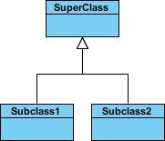

Class Relationship
A class may be involved in one or more relationships with other classes. A relationship can be one f the following types:
Inheritance (or Generalization):
Represents an "is-a" relationship.
An abstract class name is shown in italics.
SubClass1 and SubClass2 are pecializations of Super Class.
A solid line with a hollow arrowhead that point from the child to the parent class
Simple Association:
A structural link between two eer classes.
There is an association between Class1 and Class2
A solid line connecting two classes
o
s
p

Slide 19

Class Relationship
Aggregation:
A special type of association. It re resents a "part of" relationship.
Class2 is part of Class1.
Many instances (denoted by the *) of Class2 can be associated with Class1.
Objects of Class1 and Class2 have separate lifetimes.
A solid line with an unfilled diamond at the association end connected to the class of composite
p

Slide 20

Behavioral Models : State Diagram
It is used to describe the behaviour of systems.
It requires that the system described is composed of a finite number of states.
A state diagram consists of states, transitions, e ents, and activities. You use state diagrams to illustrate the dynamic view of a system. They ar especially important in modelling the behavior of an interface, class, or collaboration. State dia rams emphasize the event-ordered behavior of an object, which is especially useful in modelling reactive systems.
v
e
g
Reading Commands
State Name
State Diagram Notation
System status = “ready”
State Variables
Display msg = “enter cmd”
Display status = steady
Entry/subsystems ready Do: poll user input panel Do: read user input
Do: interpret user input
State Activities

Slide 21
Activity & Swimlane Diagram
A Swimlane diagram is a type of flowchart that delineates who does what in a process. Using the metaphor of lanes in a pool, a Swimlane diagram provides clarity and accountability by placing process steps within the horizontal or vertical “Swimlanes” of a particular employee, work group or department.
Activity diagram is basically a flowchart to represent the flow
from one activity to another activity
The activity can be described as an operation of the system.
A swimlane diagram is a type of activity diagram. Like activity diagram, it diagrams a process from start to finish, but it also divides these steps into categories to help distinguish which departments or employees are responsible for each set of actions
A swim lane diagram is also useful in helping clarify responsibilities and help departments work together in a world where departments often don't understand what the other departments do

Slide 22

ActivityDiagram Symbols
Start
Note
Activit y
Receive Signal
Connector
Send Signal
Join
Option Loop
Fork
End
Decision

Slide 23
Activity diagram o order processing
f
o
Send order by the customer, Receipt of the
rder, Confirm the order, Dispatch the order
Customers sends
Order request system con irms the
[Check if the order is Normal order]
an order request
receipt of order
[No]
[Check if the order
is Special order]
[Yes]
[No]
[Yes]
Confirm the Order
Dispatch the Order

Slide 24
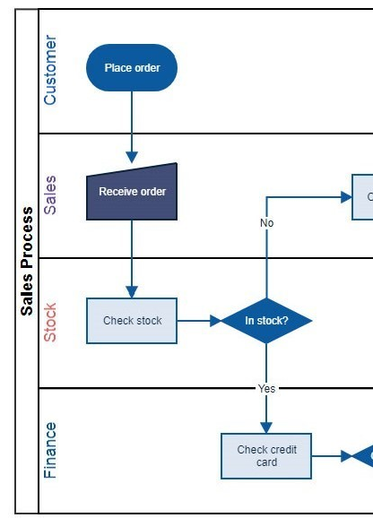
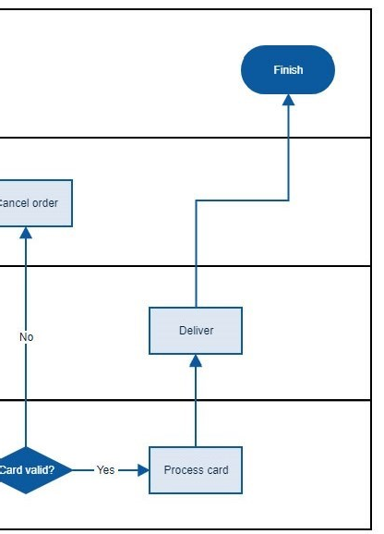
Swimlane diagram of order processing

Slide 25
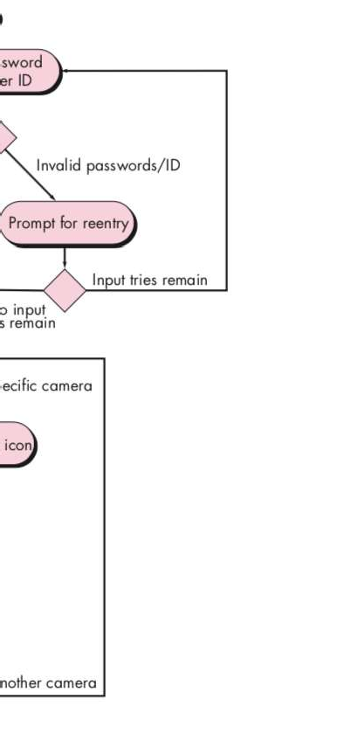
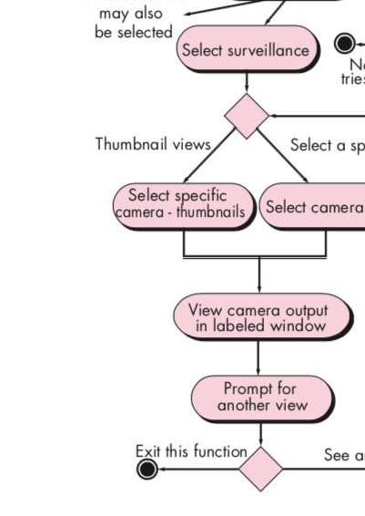
Activity diagram for Access camera surveillance via the Internet— display camera views function.

Slide 26
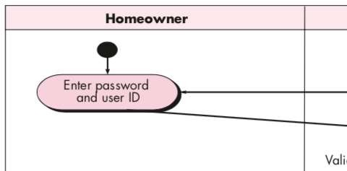
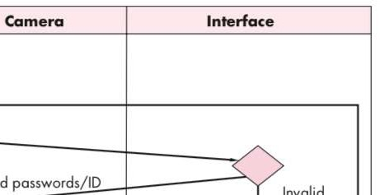
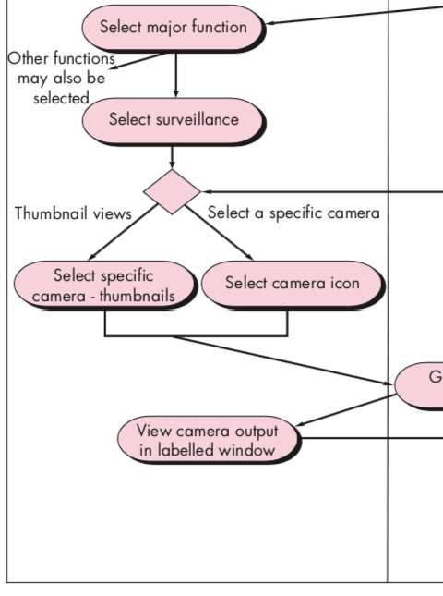
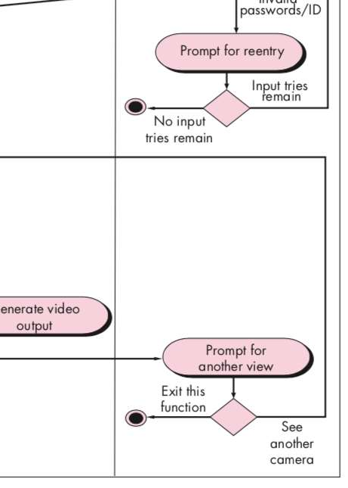
Swimlane diagram for Access camera surveillance via the Internet—display camera views fu ction
n

Slide 27
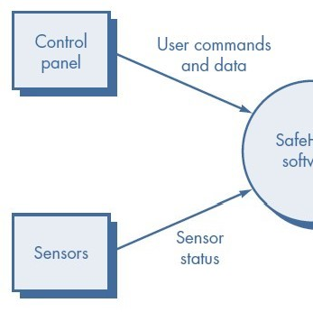
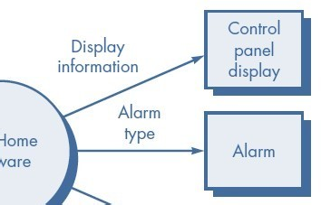
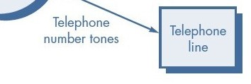
Data Flow Model: Data Flow Diagram (DFD)
It is a graphical representation of the "flow" of data through an information system, modelling its process aspects
It is often used as a preliminar step to create an overview of the system, which can later be elaborated
y
Level 0: Context-level DFD for the
S
afeHome security function

Slide 28
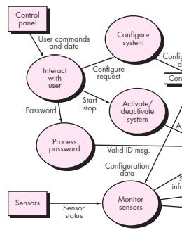
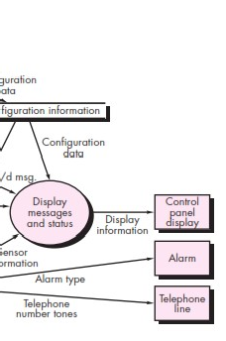
Data Flow Model: DFD Level 1

Slide 29
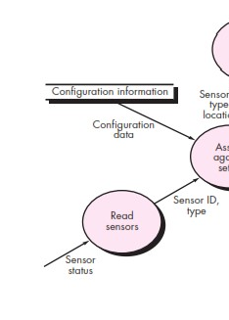
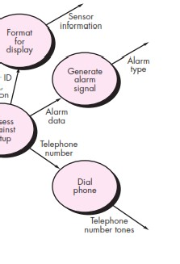
Data Flow Model: DFD L vel 2 (Monitor Sensor)
e

Slide 30
Data Flow Notations
Input / Output
Process/ Function
Flow
Data Store

Slide 31

Requirements Engineering Tasks
4
Negotiation
Reconcile conflicts
Agree on a deliverable system that is realistic for developers and customers
Negotiation is not a contest or a game. It works best when both parties win. There are many instances in which you and other stakeholders must negotiate functions and features, identified problems, Risk, priorities, and delivery dates. If the team has collaborated well, all parties have a common goal. Still, negotiation will demand compromise from all parties. Out ut of Negotiation process is consensuses.
p

Slide 32



Art of negotiation
Recognise that it is not competition Map out a strategy
Listen actively
Focus of other party’s concern Don’t get it personal
Be creative
Be ready to commit

